Slide 1
Work Progress
By: Abdur Rehman

Slide 2
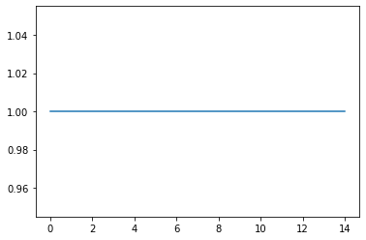
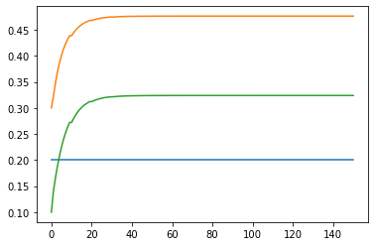
Plant Model: Continuously Stirred Tank Reactor (CSTR)
Seeing the result of how the input - “cAin” impact the result of the simulation
“cAin” = 1
Plant Measurement
Plant State

Slide 3
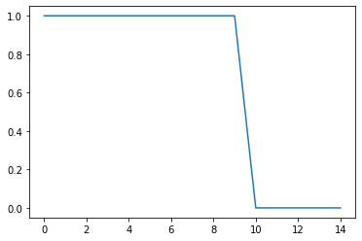
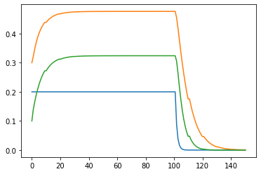
Generation of random STEP Input - “cAin” to see the steady state value
“cAin” = von 0 bis 1 (randomly generated)
cAin
Plant States

Slide 4
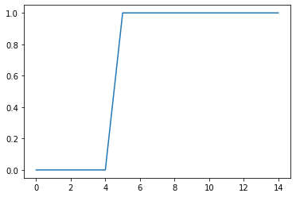
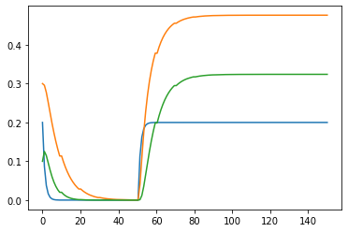
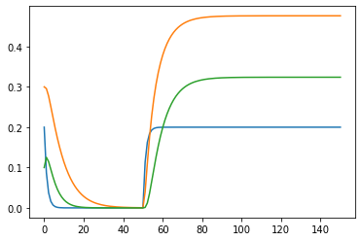
Generation of random STEP Input - “cAin” to see the steady state value
“cAin” = von 0 bis 1 (randomly generated)
cAin
Plant States

Slide 5
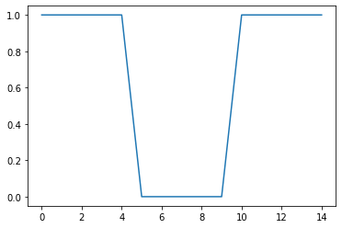
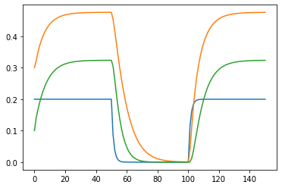
Generation of random STEP Input - “cAin” to see the steady state value
“cAin” = von 0 bis 1 (randomly generated)
cAin
Plant States

Slide 6
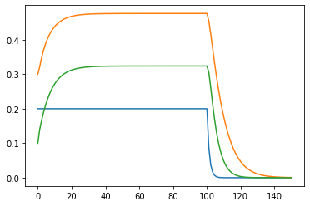
Generation of random STEP Input - “cAin” to see the steady state value
“cAin” = von 0 bis 1 (randomly generated)
cAin
Plant States

Slide 7
NARX (Nonlinear Autoregressive Exogenous Model) An Introduction
In time series modeling, NARX is a nonlinear autoregressive model which has to have exogenous inputs.
Which means that the model relates the current value of a time series to both:
past values of the same series; and
current and past values of the driving (exogenous) series.

Slide 8
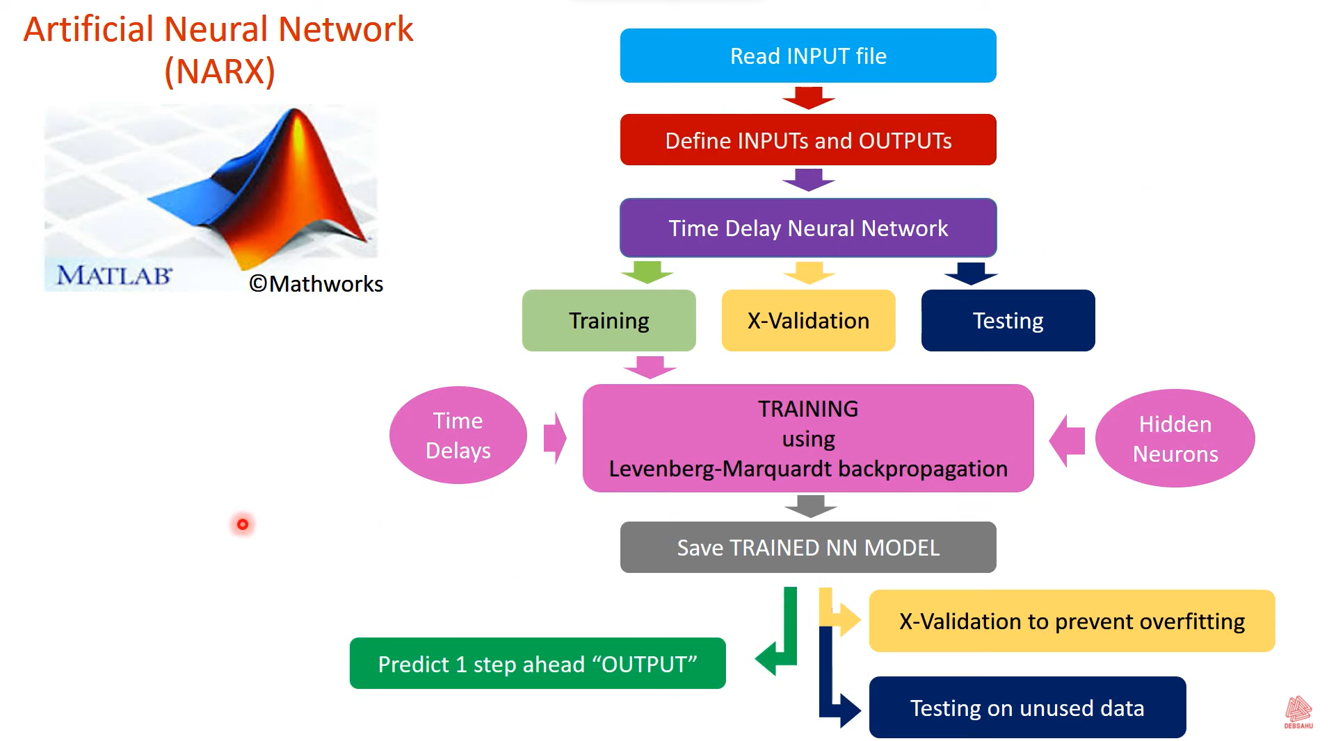
General Procedure

Slide 9
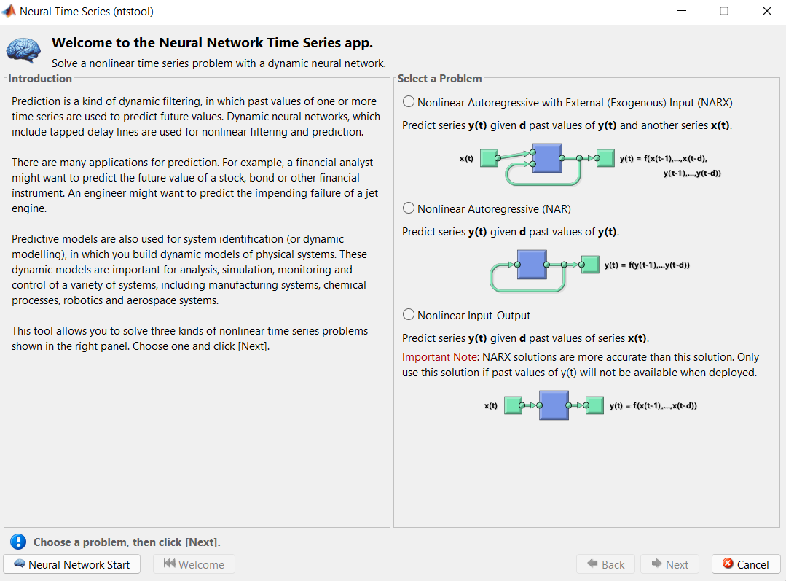
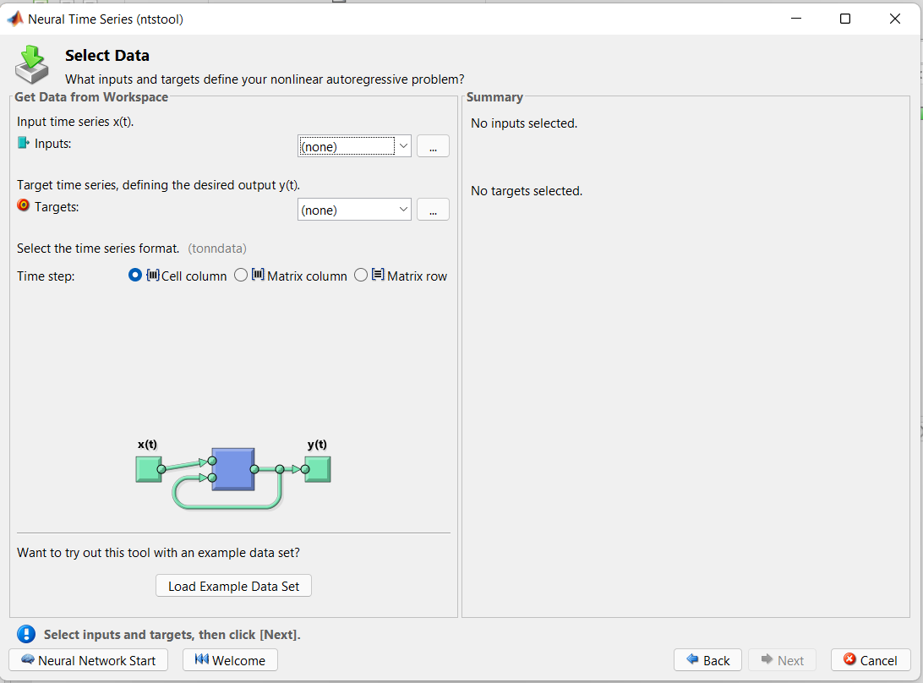
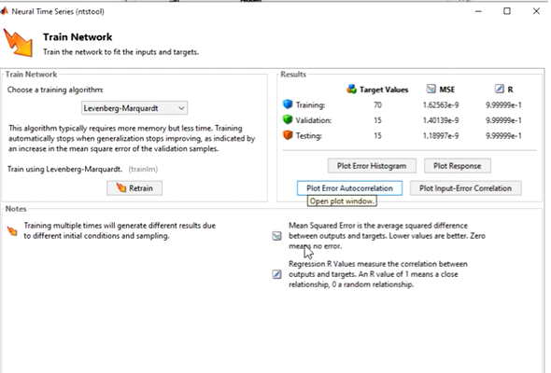
MATLAB: Via ntstoll
MATLAB Command Prompt: ntstoll
To solve a non linear time series problem with a Dynamic Neural Network via NARX, NAR and Non linear Input and Output.
Apply Input and Output Target
Define Validation and Test Data
Define Network Architecture
Train Network
Error Auto Correlation Plots to validate the Network Performance

Slide 10
Python Neural Genetic Algorithm Hybrids
Install Python library at the Python prompt:
easy_install pyneurgen
The second step is to import the modules, and initialize the data.
Now, we need to set up inputs and targets
The normalization of data should be done individually for each project.
Import and instantiate the main class NeuralNet
NeuralNet()
Specifies a network structure of inputs, hidden layer of nodes, and finally, output
In addition, the learn rate is set
The next step in the process is to randomize the weights of each connection.
Now that the network structure is created, the inputs and targets are loaded into the system.

Slide 11
The activation types for a network default to 'linear' for the input layer, 'sigmoid' for the hidden layers, and 'linear' for the output.
We can now start the network learn process which sets the appropriate weights for each connection.
With learning complete, it is time to test and evaluate the results.
To view the results we can use some matplotlib charts.

